Slide 1
Transformers
INPUT
je suis étudiant
The
Transformer
Basics to Implementation
OUTPUT
I am a student

Slide 2
Introduction
To process sequential input data, such as natural language, with applications towards tasks such as translation and text summarization
A special type of neural network was designed known as RNN
RNN: Recurrent Neural Networks
LSTM: Long Short Term Memory
GRU: Gated Recurrent Units

Slide 3
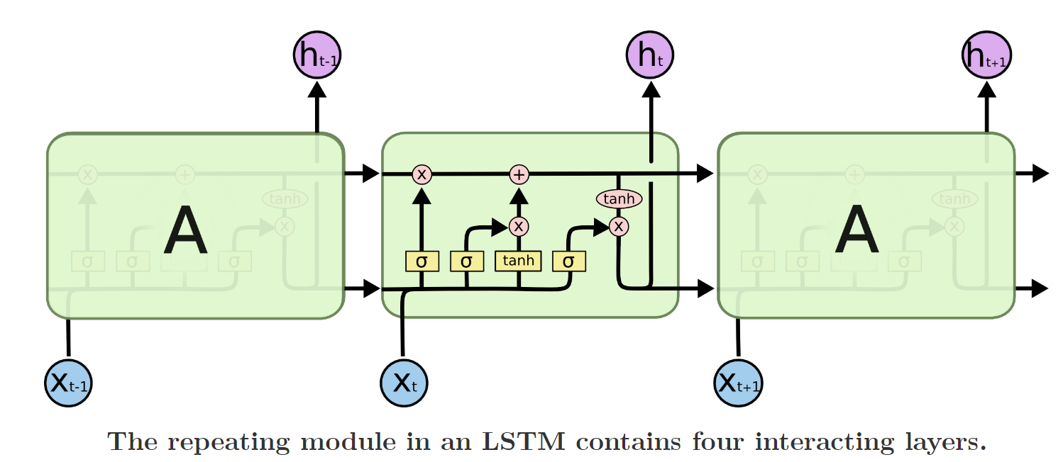
RNN and LSTM
RNNs were used for multiple applications:
Speech recognition,
Language modelling,
Translation,
Text Summarization
Image captioning…
“LSTMs” – are a special kind of RNN, capable of learning long-term dependencies. LSTMs has three main gates:
Forget gate
Input Gate
Output Gate

Slide 4
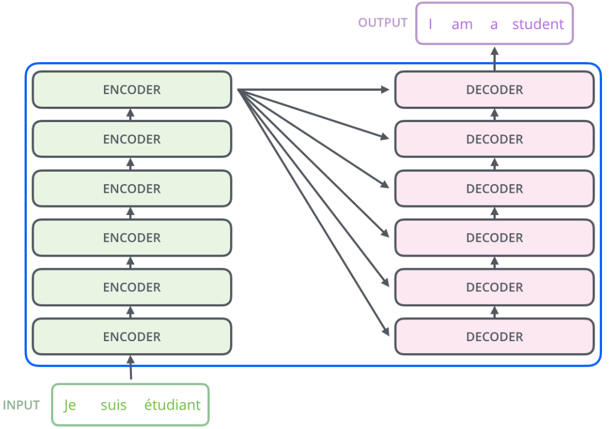
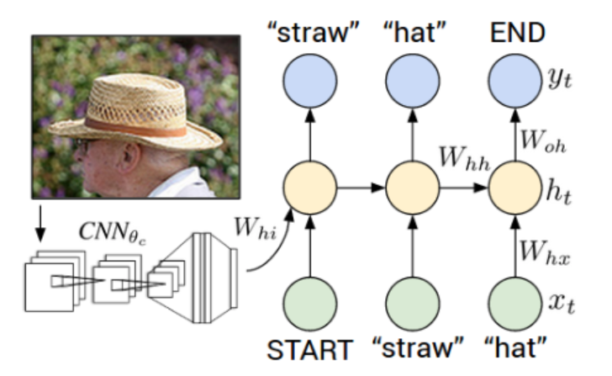
Encoder & Decoder Models
RNN Sequence to Sequence Models
Machine Translation Task
Image Captioning/ Descriptions

Slide 5
Attention

Slide 6
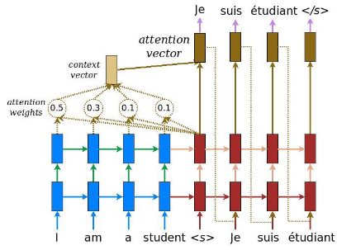
How Attention Works?

Slide 7
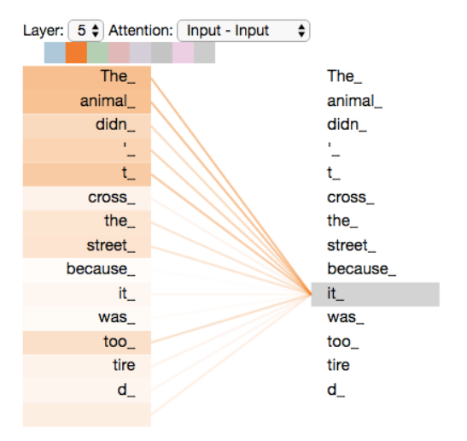
Transformers

Slide 8
Bert
BERT: Bidirectional Encoder Representations from Transformers
MNLI: Multi-lingual Natural Language Inference
QQP: Question-Question Pair
SQuAD: Stanford Question Answering Dataset

Slide 9
Applications for Transformers
Sentiment Analysis
Question- Answering
Translation
Text
Summarization
Text Classification
Name Identity
Recognition(NER)
Speech Recognition
Language Modelling
Image Captioning

Slide 10
Resources
http://karpathy.github.io/2015/05/21/rnn-effectiveness/
http://colah.github.io/posts/2015-08-Understanding-LSTMs/
https://arxiv.org/abs/1409.3215
https://arxiv.org/abs/1406.1078
https://cs.stanford.edu/people/karpathy/cvpr2015.pdf
http://jalammar.github.io/illustrated-transformer/
https://arxiv.org/pdf/1706.03762.pdf
http://jalammar.github.io/illustrated-bert/
https://arxiv.org/pdf/1810.04805.pdf
https://arxiv.org/pdf/1409.0473.pdf
https://arxiv.org/pdf/1502.03044.pdf
http://emnlp2014.org/papers/pdf/EMNLP2014179.pdf
https://jalammar.github.io/visualizing-neural-machine-translation-mechanics-of-seq2seq-models-with-attention/

Slide 11
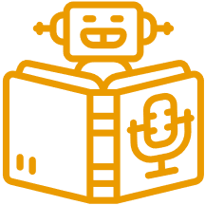
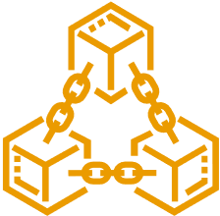
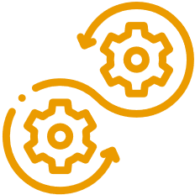
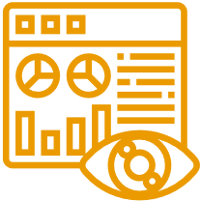
Introduction
Decoding Innovation InAI/ML, Blockchain, DevOps and Data Science
Many organizations are afraid to take the leap toward AI/ML, Blockchain, DevOps, and Data Science. MoogleLabs makes the journey streamlined and smooth for you. Founded by seasoned IT experts, the company has the resources to help your business embrace new-age technology.
At MoogleLabs, we help you compete effectively by leveraging cutting-edge technology and in this endeavor, we have a talented team, which is certified in the technologies it works on. We have transformed businesses with our deep understanding of technology that can be utilized for various industries. The company is known for building a great client-business relationship by being transparent throughout the whole journey. MoogleLabs is always ready to better itself to provide the best services to its clients.
Artificial Intelligence
Machine Learning
Blockchain
DevOps
Data Science
Our Applied AI brings roadmap to scale enterprise-grade solutions, with the power of analytics, automation and next-level computing.
Scale up your business with future-ready ML-powered applications integrated with AR/VR, image & video analytics.
We help you build a secured decentralized solution for Smart Contracts, Crypto-token and NFT Marketplace.
We specialise in DevOps managed services including CI/CD, Infrastructure Management, Cloud Managed Services, DevSecOps, and AI Ops.
Uncover hidden stories in data and turn it into maximized revenue opportunities using qualitative and quantitative data processing techniques.

